Slide 1
COURSERA CAPSTONE
IBM Applied Data Science CapstoNe
Opening a new Shopping Mall in Bangalore, India
By: Navin Kumar Singh
August 2020

Slide 2
Business Problem
Location of the shopping mall is one of the most important decisions that will determine whether the mall will be a success or a failure
Objective: To analyse and select the best locations in the city of Bangalore, to open a new shopping mall in particular area
This project is timely as the city is currently suffering from oversupply of shopping malls
Business question
In the city of Bangalore if a property developer is looking to open a new shopping mall, where would you recommend that they open it?

Slide 3
Data
Data required
List of neighbourhoods in Bangalore, India
Latitude and longitude coordinates of the neighbourhoods
Venue data, particularly data related to shopping malls
Sources of data
Wikipedia page for neighbourhoods (https://commons.wikimedia.org/wiki/Category:Suburbs_of_Bangalore)
Geocoder package for latitude and longitude coordinates
Foursquare API for venue data

Slide 4
Methodology
Web scraping Wikipedia page for neighbourhoods list.
Get latitude and longitude coordinates using Geocoder.
Use Foursquare API to get venue data.
Group data by neighbourhood and taking the mean of the frequency of occurrence of each venue category.
Filter venue category by Shopping Mall.
Perform clustering on the data by using k-means clustering.
Visualize the clusters in a map using Folium.

Slide 5
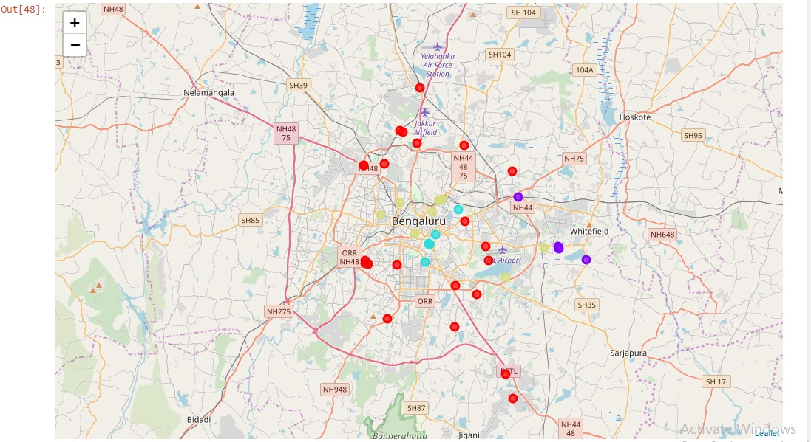
Results
Categorized the neighbourhoods into 4 clusters :
Cluster 0: Neighbourhoods with low number to no existence of shopping malls
Cluster 1: Neighbourhoods with high concentration of shopping malls
Cluster 2: Neighbourhoods with equal concentration shopping malls
Cluster 3: Neighbourhoods with moderate shopping malls

Slide 6
Discussion
Main focusing shopping Mall around the Bangalore city
Highest number in cluster 1 and moderate number in cluster 3
Cluster 2 has equal focusing area where the all area is good for openning.
Cluster 0 has very low number to no shopping mall in the neighbourhoods
Oversupply of shopping malls mostly happened in the central area of the city, with the suburb area still have very few shopping malls
Property developers are advised to avoid neighborhoods in cluster 2 which already have high concentration of shopping malls and suffering from intense competition.

Slide 7
Recommendations
Open new shopping malls in neighbourhoods in cluster 0 with little to no competition
Can also open in neighbourhoods in cluster 3 with moderate competition if have unique selling propositions to stand out from the competition
Avoid neighbourhoods in cluster 1, already high concentration of shopping malls and intense competition
In cluster 2 is also a good area where the investors invest and start the business but one thing keep in mind that in this area sell the different things .

Slide 8
Conclusion
Answer to business question: The neighbourhoods in cluster 0 are the most preferred locations to open a new shopping mall
Findings of this project will help the relevant stakeholders to capitalize on the opportunities on high potential locations while avoiding overcrowded areas in their decisions to open a new shopping mall.
Moreover , the start a new shopping complex or mall stakeholders should be checks and find the accurate area once again and then invest.

Slide 9
